Slide 1
Designing Mobile Applications
Notes:
Way of thinking about creating products and services
Even if you are never going to create a mobile version start designing for mobile

Slide 2
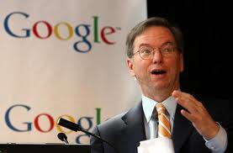
Don’t believe me, believe Google!
Google programmers are doing work on mobile applications first because they are better apps and that what top programmers want to develop.
Eric Schmidt
Notes:
High volume endpoint
Computing power
Connectivity
Cloud based resources

Slide 3
Why starting with mobile?
Growth = Opportunity
Constraints = Focus
Capabilities = Innovation

Slide 4
Considerations
Multiple screen sizes and densities
Performance optimization
Touch targets, gestures and actions
Location systems
Device capabilities

Slide 5

Growth = Opportunity

Slide 6
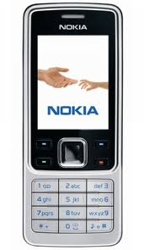
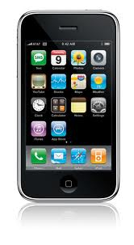
Growth = Opportunity
In next years up to 90% of the mobile market will be smartphones
Notes:
Feature phone experience is bad, but we are moving towards smartphones

Slide 7
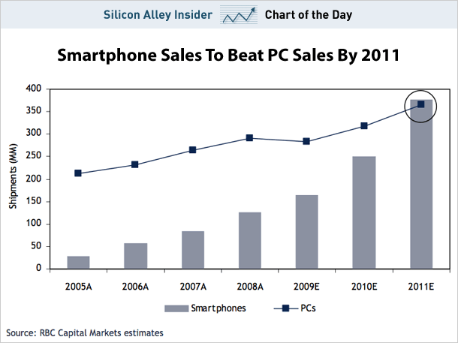
Growth = Opportunity
Mobile web growth has outpaced desktop web growth 8x
Notes:
Mobile data is growing 180%

Slide 8
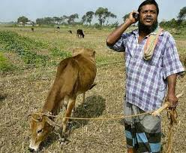
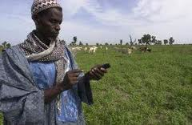
Growth = Opportunity
People come online on mobile first on new markets.
Notes:
Mobile data is growing 180% per year

Slide 9
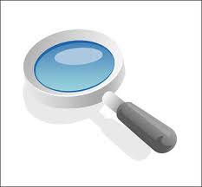
Constraints = Focus
Notes:
Screen size
Focus on core actions
Know your users
Use scalable design

Slide 10
Constraints = Focus
Screen size
Focus on core actions
Know your users
Use scalable design

Slide 11
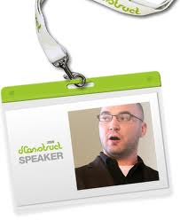

Constraints = Focus
Create a product!
Don’t just reimagine one for small screens.
Great products are created from scratch never ported!
Brian Fling

Slide 12
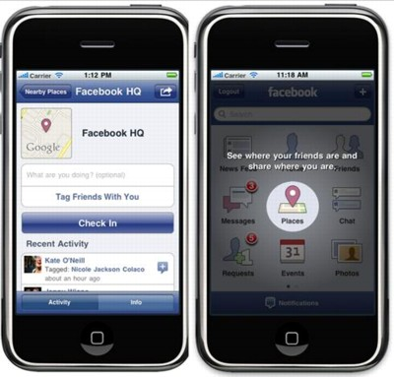
My goal was initially just to make a mobile companion, but I became convinced that it was possible to create a version of FB that was actually better than the website.
Joe Hewitt
Notes:
Additional engangement
People on fb mobile 50% more active than those on website

Slide 13
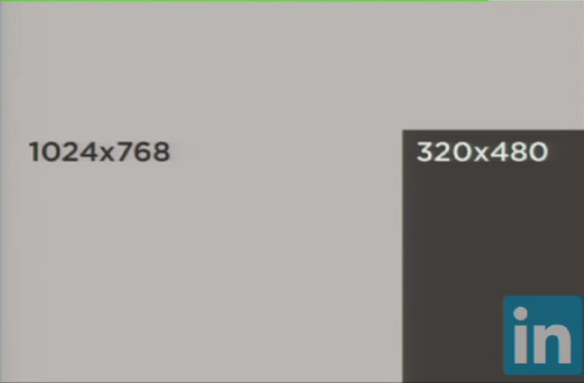
Screen size

Slide 14
Focus on core actions
The main function should be immediately apparent !!
Notes:
Focus
You have to know what really matters
Learn to make things more simple

Slide 15
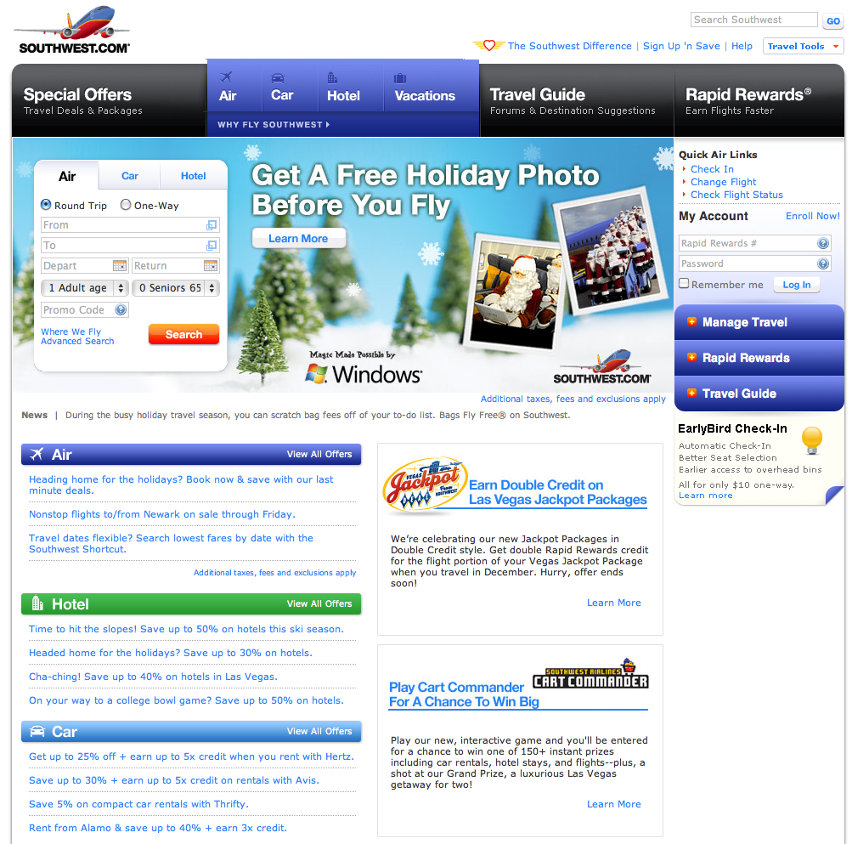
Focus on core actions
Notes:
Focus
You have to know what really matters
Learn to make thing more simple

Slide 16
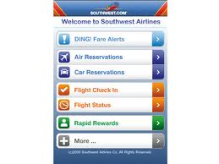
Focus on core actions
Notes:
Focus
You have to know what really matters
Learn to make thing more simple

Slide 17
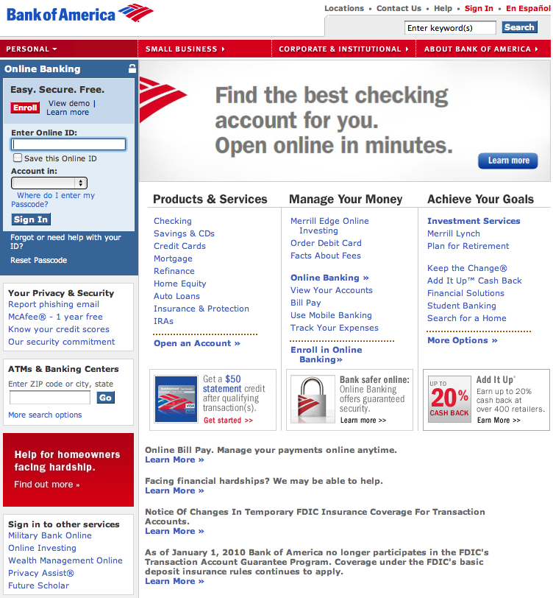
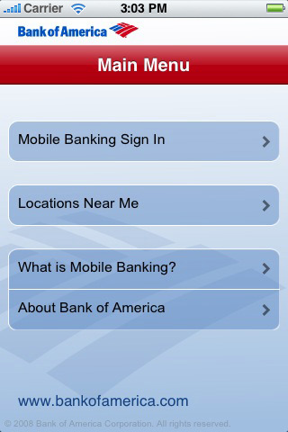
Focus on core actions

Slide 18

Focus on core actions
60 menu items on the actual website
9 items on the mobile version

Slide 19


Slide 20
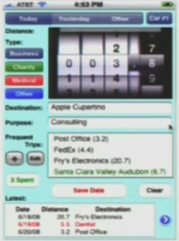
App design matters!
Users are expecting a well designed mobile experience

Slide 21
Design for multiple screen sizes
Iphone 3G
320x480 3,5in 164ppi
Motorolla Droid, Nexus One
480x854 3.7in 264ppi
Iphone 4
960x640 3,5in 326ppi

Slide 22
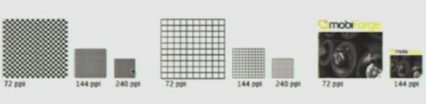
The impact of ppi
Notes:
Work with a vector

Slide 23
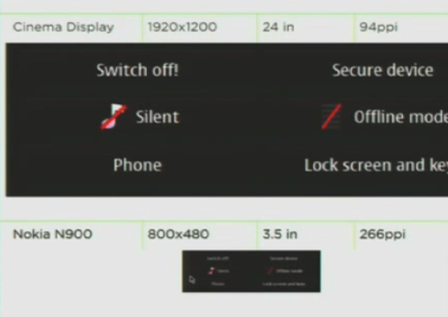
The impact of ppi
Notes:
Work with a vecto-based program and be able to scale your designs

Slide 24
What devices are we targeting?
Define device groups
Create a default reference design
Define rules for content and design adaptation
Opt for web standards and flexible layout

Slide 25
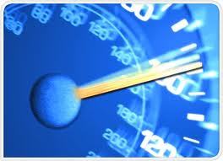
Speed

Slide 26
Some tips
Keep performance on top of mind
Reduce requests and file size
Eliminate redirects
Use css sprites to serve multiple images
Consolidate css and js into a single file
Minify your code
Take advantage of HTML5
Load content lazily
Use application cache for local content storage
Use css 3 and canvas tag instead of images where possible.

Slide 27



Performance matters
100ms delay results in 1% sales loss
500ms delay drops search traffic by 20%
According to study if you do it consistently over a period of 2 weeks you lose the users permanently.
400ms delay results in 5-9% drop in full page traffic

Slide 28
Context
Quick bursts everywhere
One handed interactions !!

Slide 29
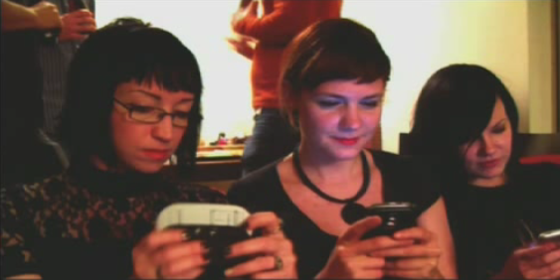
During a typical day
84% at home
80% during misc times throughout the day
74% waiting in lines
64% at work
Notes:
Design for something that people use all the time
They don’t use the desktop all the time but they use their phone

Slide 30
Use cases for mobile apps
Social
Facebook, Twitter
Entertainment
Angry Birds
Communication
Email, Skype
Local
Yelp, Maps
Information
Google search, Wiki
Utilities
Calendar, Flashlight
Notes:
Access to facebook grew 112% in the past year
Access to twitter via mobile browser jumped 347% in January 2010

Slide 31
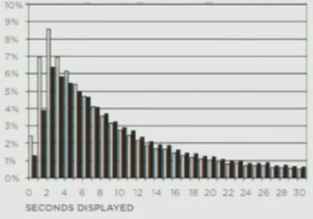
Browsing patterns
25% of documents displayed for less than 4s
52% of all visits were shorter than 10s
Peak value was located between 2 and 3 sec

Slide 32
One handed interactions
Simplify UI
Big buttons

Slide 33
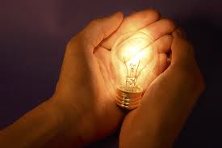
Capabilities = Innovation

Slide 34
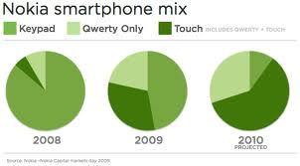
Touch
Notes:
Nokia stats on touch enabled devices

Slide 35
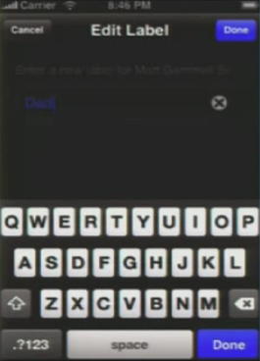
Touch
Apple recommends a minimum target size
29px wide
44px tall
Notes:
Nokia stats on touch enabled devices

Slide 36
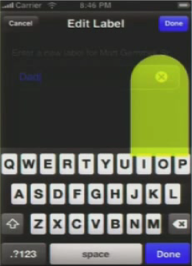
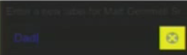
Touch
Apple recommends a minimum target size
29px wide
44px tall
Notes:
Nokia stats on touch enabled devices

Slide 37
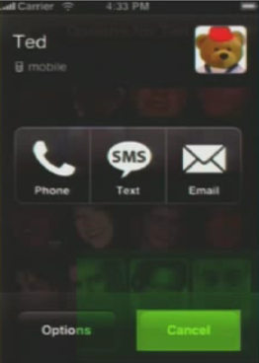
Target sizes for slipping fingers
Add room for error

Slide 38
Touch gestures
Tap (multi)
Double tap
Drag (multi)
Flick
Pinch (multi)
Spread (multi)
Press
Press & tap
Press & drag
Rotate

Slide 39
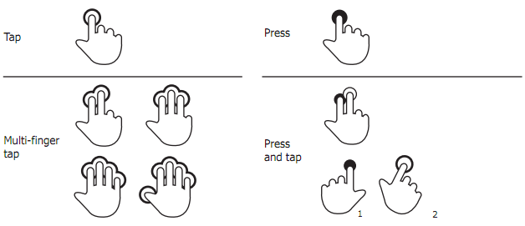
Tap & Press

Slide 40
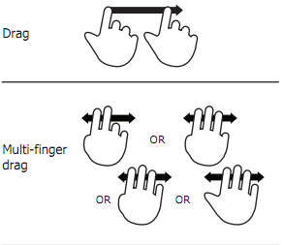
Drag

Slide 41
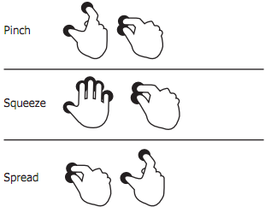
Pinch & spread

Slide 42

Rotate

Slide 43
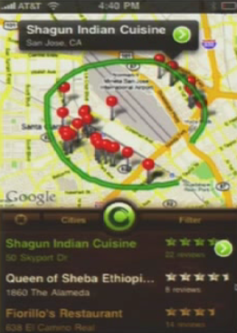
Gestures as input

Slide 44
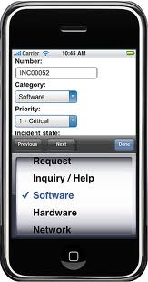
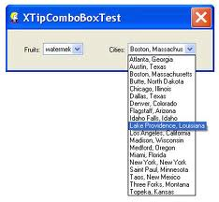
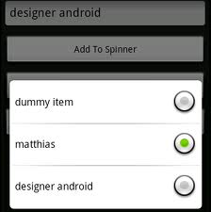
Comboboxes

Slide 45
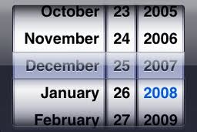
Picker controls

Slide 46
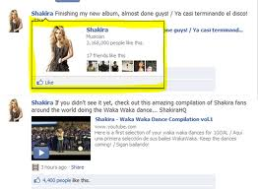
No hover
Maybe good because of hover overload
Hover is not an intentional user action

Slide 47
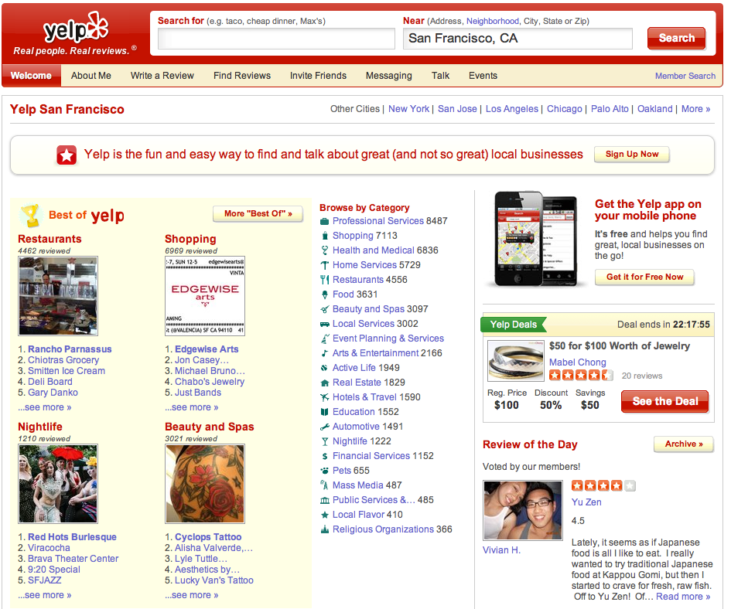
Location as input

Slide 48
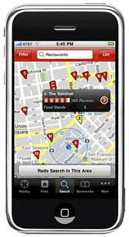
Location as input

Slide 49
Geo location methods
GPS
Best quality
High battery consumption
Wifi
100m accuracy
Cell tower triangulation
Minimal battery consumption
Good for most cases
IP address
Only good on a country level. Maybe city.

Slide 50
Context aware computing
Being in a place provides context
What can you infer now ?
Throw time in the mix
How about now?

Slide 51
Mobile Device Capabilities
Application cache for local storage
CSS 3 & Canvas for performance optimization
Multitouch sensors
Location detection
Device positioning & motion: Accelerometers
Orientation: Digital compass
Audio: Microphone
Video & Image: Camera
Push real-time notifications
Peer to Peer connections: Bluetooth or WiFi
Ambient light: light/dark environment awareness
RFID reader: identify & track objects with broadcasted identifiers
Haptic feedback: feel different surfaces on a screen
Biometrics: retinal, fingerprints, etc.

Slide 52
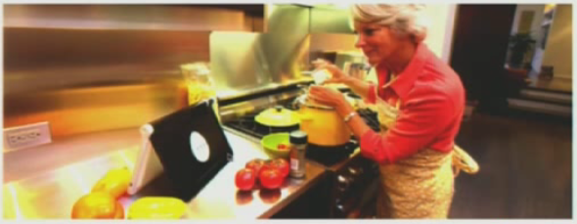
Multiple orientation

Slide 53
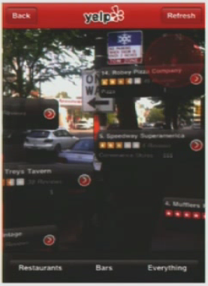
Location and Orientation as input

Slide 54
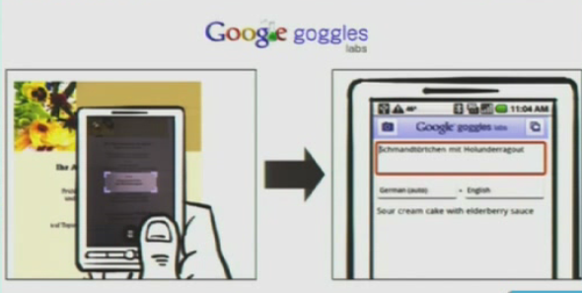
Images as input

Slide 55
So what are my options?
Native
Objective C, Java Android
Web
HTML5,CSS3, Javascript
Hybrid?
PhoneGap, Titanium, Rhodes

Slide 56
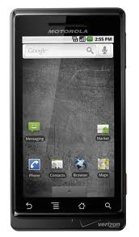
Iphone vs Android
Notes:
Iphone is better because it doesn’t have the notion of the menu and allows for adding all helpful items on the screen
In android the menu allows to add items that are probably not necessary
Forces you to not have a miscallenous bin
And focus on natural interaction to get more content (Make content the action

Slide 57
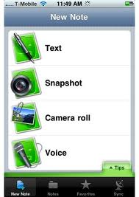
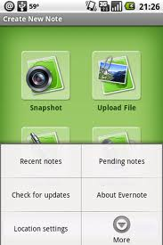
Iphone vs Android
Notes:
Iphone is better because it doesn’t have the notion of the menu and allows for adding all helpful items on the screen
In android the menu allows to add items that are probably not necessary
Forces you to not have a miscallenous bin
And focus on natural interaction to get more content (Make content the action

Slide 58
Dive into technical stuff
What is AJAX ?
How to make asynchronous Web requests ?
Using jQTouch to set up touch events.
Animations with jQTouch.

Slide 59
jQuery recap
$("#hello"); //id:hello
$(".hello"); //class:hello
$("div"); //all divs
$("div", "#main"); // all divs inside main
$("div").each(function(){
$(this).doSomething();
}); // act on every div
$("#hello").css("background-color", "black");

Slide 60
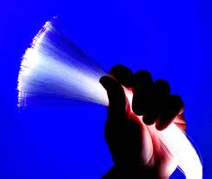
Network & Javascript

Slide 61
Topics
GET vs POST
Asynchronous vs Synchronous
XML vs JSON

Slide 62
Basics: GET & POST
GET http://example.com/index.html?hello=yes&goodbye=no
No message body
Query is in the URL
Shouldn't change data on server
POST http://example.com/index.php
Message body has parameters
Can have side-effects, change data on server
Can carry more data
This is an action

Slide 63
In other words...
fetch using GET
change using POST

Slide 64
AJAX
Asynchronous
Javascript
And
XML

Slide 65
What does asynchronous mean?
In context of network connections: let other stuff happen while a network request is going on

Slide 66
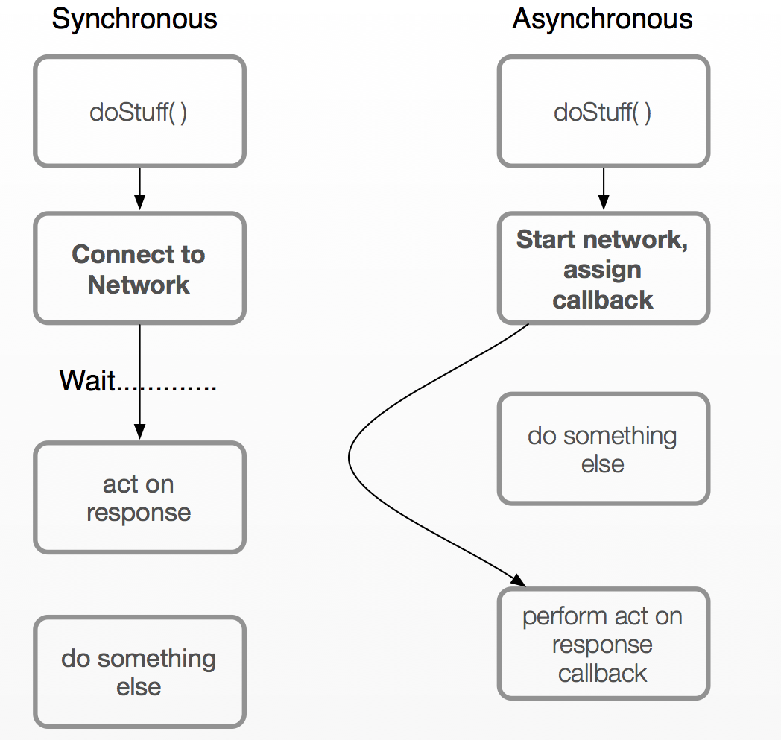

Slide 67
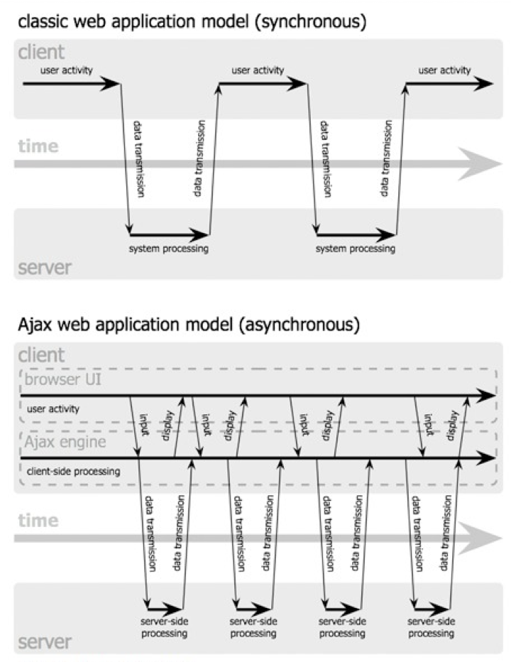

Slide 68
XML?
Many people use JSON instead of XML
easier to build/parse than XML

Slide 69
What is JSON?
JavaScript Object Notation
Takes the array, object, and string notation from JS & makes it a transport format (can send around a string that evaluates to JSON)

Slide 70
Sample JSON
{
classes: [{
"name":"SAE",
"location": "Ampth 1”
},{
"name":"Diktia",
"location": ”Aith 2”
}
]}

Slide 71
Sample JSON
{
classes: [{
"name":”SAE",
"location": ”Ampth 1”
},{
"name":”Diktia",
"location": ”Aith 2”
}
]} // this is an object with an array inside that contains two objects

Slide 72
JSON.parse( )
Takes JSON data, encoded in a string
Returns an object you can use in JS

Slide 73
Example
>> var a = "[5,4,3,2,1,\"hello\"]"
>> var b = JSON.parse(a);
>> a.length
6
>> a[5]
"hello"

Slide 74
JSON.stringify
Takes a Javascript Array, Object, or String, and turns it into JSON

Slide 75
Example
var a = {"dog":"bark", "cat":"meow"};
>> JSON.stringify(a);
"{\"dog\":\"bark\", \"cat\":\"meow\"}"

Slide 76
Asynchronous Requests in jQuery
overall function: .ajax()
Shortcuts: .get, .post, .getJSON

Slide 77
$.ajax
var options = {
data: {
"animals":["dog", "cat", "cow"]
},
dataType: "json",
error: onError,
success: successFn,
url: "/postAnimal.php”
};
$.ajax(options);

Slide 78
Success & Failure
response: {'dog':'bark', 'cat':'meow', 'cow':'moo’}
function onSuccess(data) {
$.each(data, function(i, item) {
$("<div>" + i + " says " + item + "</div>")
.appendTo("#animals");
})
}
function onError(function(request, settings) {
$("#status").append("<div>Error fetching " + settings.url + "</div>")
})

Slide 79
Shortcuts
$.get(url, data, successCallback);
// no error callback
// grabs HTML or XML
$.getJSON(url, data, successCallback);
// also no error callback
// but grabs & parses JSON

Slide 80
A simple form
<form id="mainform" method="POST" action="server.php”>
<td>Your name</td>
<td>
<input type="text" name="name"/>
</td>
<td>E-mail</td>
<td>
<input type="text" name="email"/>
</td>
<td colspan="2">
<input type="submit" value="send form"/>
</td>
</form>

Slide 81
Form submission in $
$("#mainform").submit(function(event){
var keyvals = {};
$("input[type!=submit]", "#mainform").each(function(i,el){
el = $(el);
keyvals[el.attr("name")] = el.val();
})
$.post($(this).attr("action"), keyvals, function(response){
$("#response").html(response);
})
return false; //prevents normal submit event from firing
})
Notes:
DEMO

Slide 82
jQTouch
jQTouch Basics & Workflow
Changing list input style
Overriding styles
Setting up animations
Swipes & Touches

Slide 83
jQTouch
Include it after jQuery gets loaded
There's also a “jQuery Touch”, that's a different project

Slide 84
jQTouch Basics
<head>
<style type="text/css" media="screen">@import "../jqt/jqtouch.css";<style>
<style type="text/css" media="screen">@import "../jqt/theme.css";</style>
<script src="../jquery.js" type="text/javascript" charset="utf-8"></script>
<script src="../jqt/jqtouch.js" type="text/javascript" charset="utf-8"><script>
<script type="text/javascript" charset="utf-8">
var jQT = new $.jQTouch();
</script>
</head>

Slide 85
jQTouch HTML
<div id="example" class="current">
<ul class="rounded">
<li><a href="#one">Page 1</a>
<li><a href="#two">Page 2</a>
</ul>
</div>
<div id="one">
<div class="toolbar">
<h1>Page 1</h1>
<a class="back">Back</a>
</div>This is page one.
</div>
<div id="two">
<ul>
<li>This is another page. <a href="#two">go to page 1?</a></li>
</ul>
</div>

Slide 86
Workflow
Add divs to your page with meaningful IDs
Set up links to those ids with anchors inside LIs:
<ul><li><a href="#yourid">your link</ a></li></ul>
jQTouch handles the animations
target=_blank on external links

Slide 87
Content can be fetched asynchronously
Just specify a URL instead of a hash

Slide 88
Loading asynch
<div id="example" class="current">
<ul class="rounded">
<li><a href="#one">Page 1</a>
<li><a href="jqtouch-loadme.html">Page 2</a>
</ul>
</div>
<div id="one">This is page one. </div>
Notes:
DEMO

Slide 89
Configuring webapp
var jQT = new $.jQTouch({
statusBar: 'black',
icon: 'cs.png',
addGlossToIcon: true, // defaults to true startUpScreen: ’my-start.png’
});

Slide 90
Specifying list type
Change class of <ul>
Default theme options: rounded, edgetoedge, plastic, metal

Slide 91
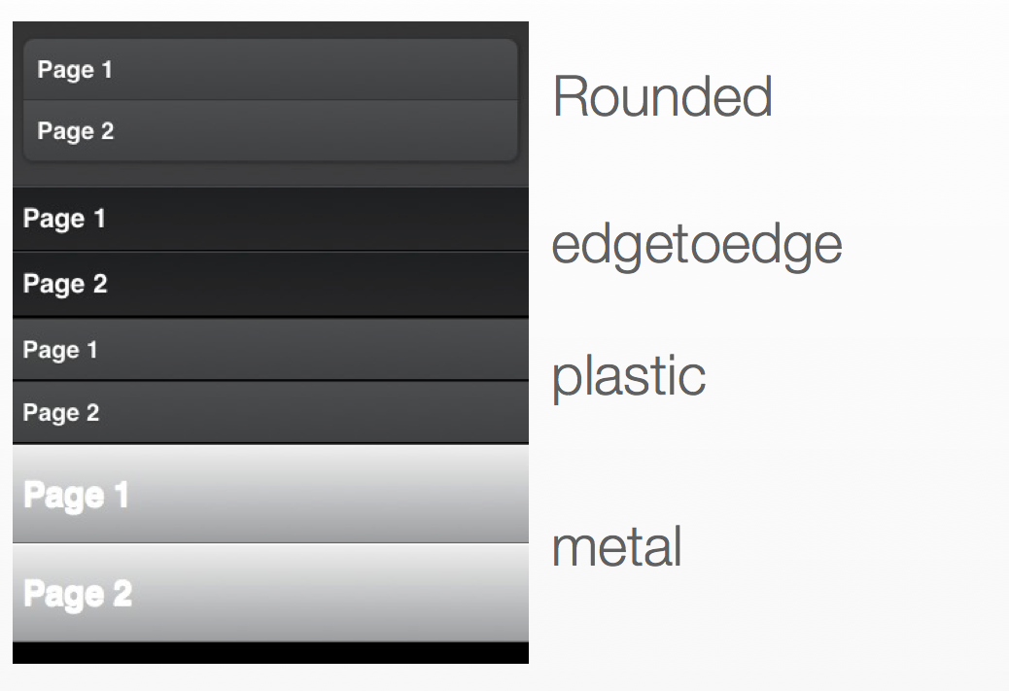
List types

Slide 92
Customization
Include basic jqtouch.css
Optionally include theme.css
Add your own styles by overwriting
Use Web Browser tools to check what styles are active

Slide 93
Specifying animation
Specify class on your <a> link

Slide 94
Available Animations
slide
slideup
dissolve
fade
flippop
swap
cube

Slide 95
Example
<div id="example">
<ul class="rounded">
<li><a class="flip" href="#one">Page 1</a>
<li><a class="swap" href="#two">Page 2</a>
</ul>
</div>

Slide 96
Detecting Touches
jQuery will set an “active” class on touch&hover for anything with a ".touch" class
Will take off the active class if the touch ends up not being a tap (if you move your finger)
And if you swipe sideways, will fire .swipe

Slide 97
Source
<script type="text/javascript" charset="utf-8">
var jQT = new $.jQTouch({});
$(document).ready(function(){
$(".touch").swipe(function(){
alert("SWIPE");
})
$(".touch").bind("touchstart", function(){
$(".touch").unselect();
})
})
</script>...
<div id="example">
<div class="touch cta">Touch this.</div>
<div class="touch cta">Or touch that.</div>
</div>
Notes:
DEMO

Slide 98
Geolocation API
navigator.geolocation.getCurrentPosition (callback)

Slide 99
Sample code
navigator.geolocation.getCurrentPosition(handlePosition)
function handlePosition(position) {
$("#lat").html(position.coords.latitude);
$("#lon").html(position.coords.longitude);
}
Notes:
DEMO

Slide 100
Getting orientation change
// event name: orientationchange
// using jQuery:
$("body').bind("orientationchange", function(event) {
react()
}

Slide 101
Source
function setOrientation() {
var orientation = (window.innerWidth < window.innerHeight) ? 'portrait' : 'landscape';
$("#orientation").html(orientation);
}
$(document).ready(function(){
setOrientation();
$("body").bind("orientationchange", function(event){
setOrientation();
}
})

Slide 102

Design Tools

Slide 103
NeedFinding
Brainstorming
Go for quantity in the beginning not quality
Do your homework
Check references to learn from previous attempts in the same area
Follow users
Yes I mean stalk them

Slide 104
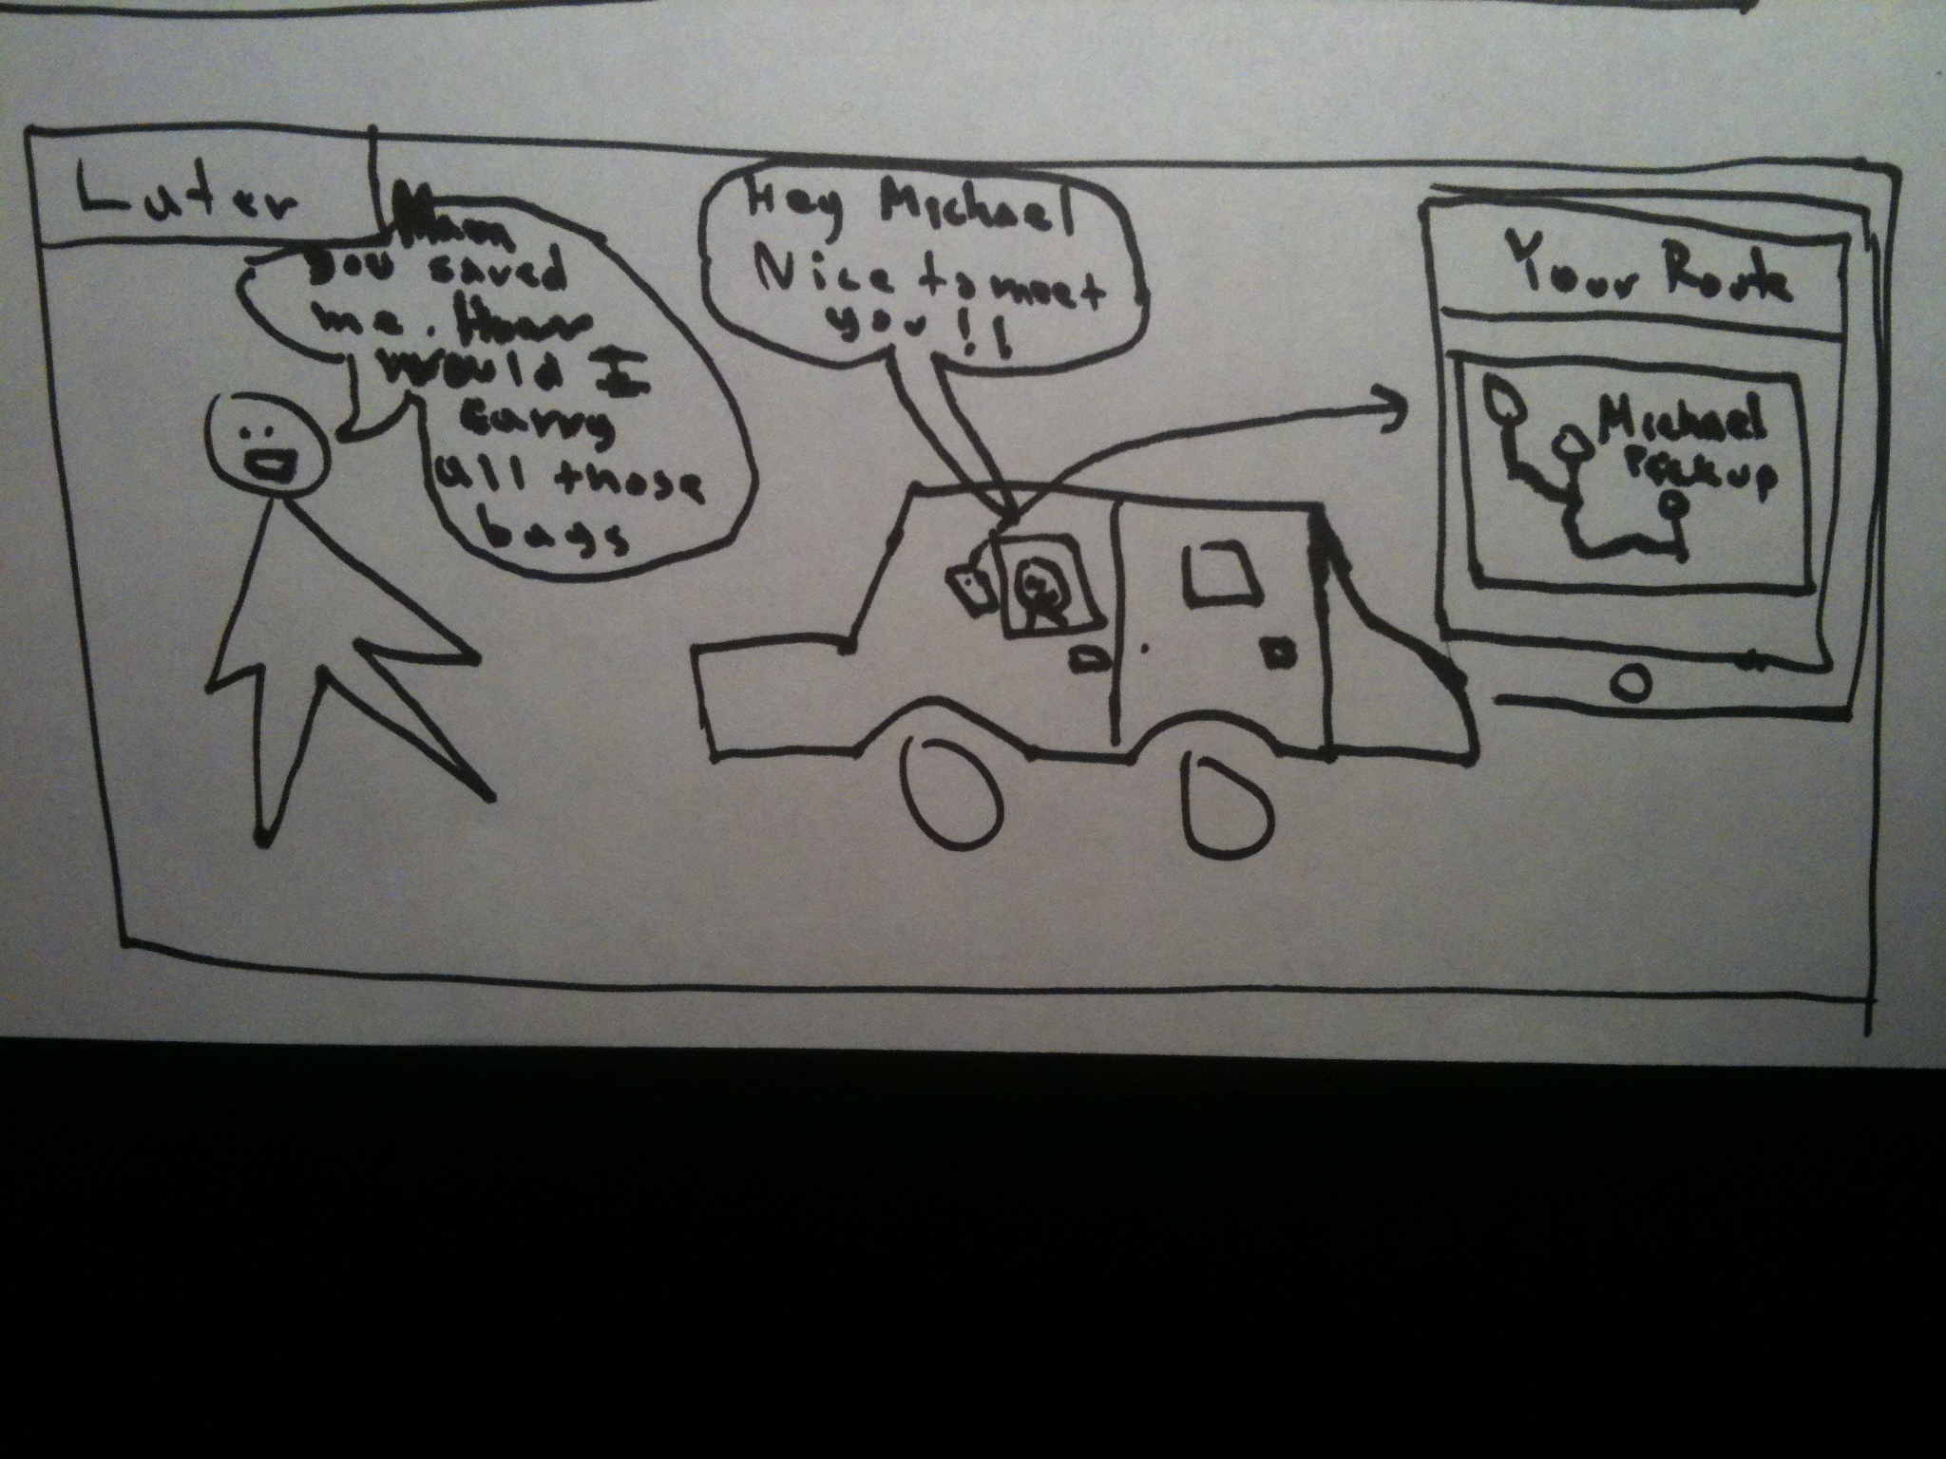
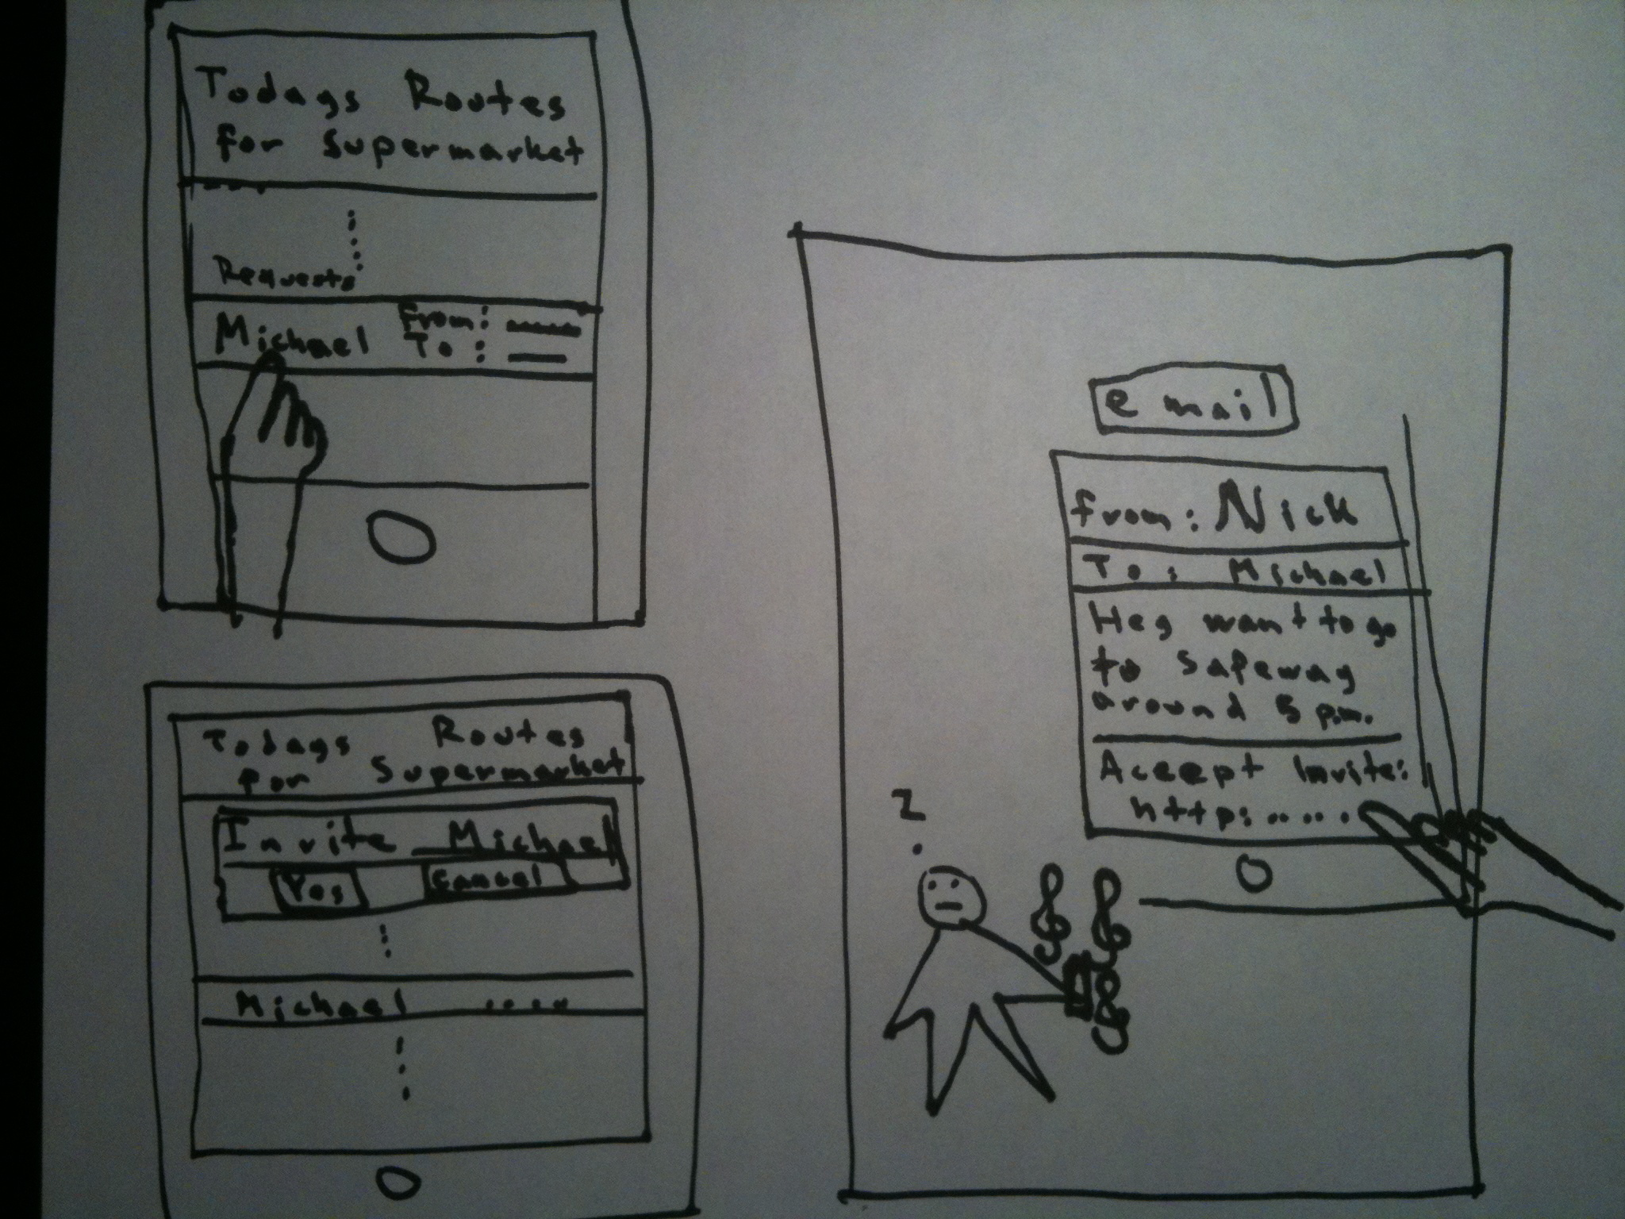
Story boarding

Slide 105
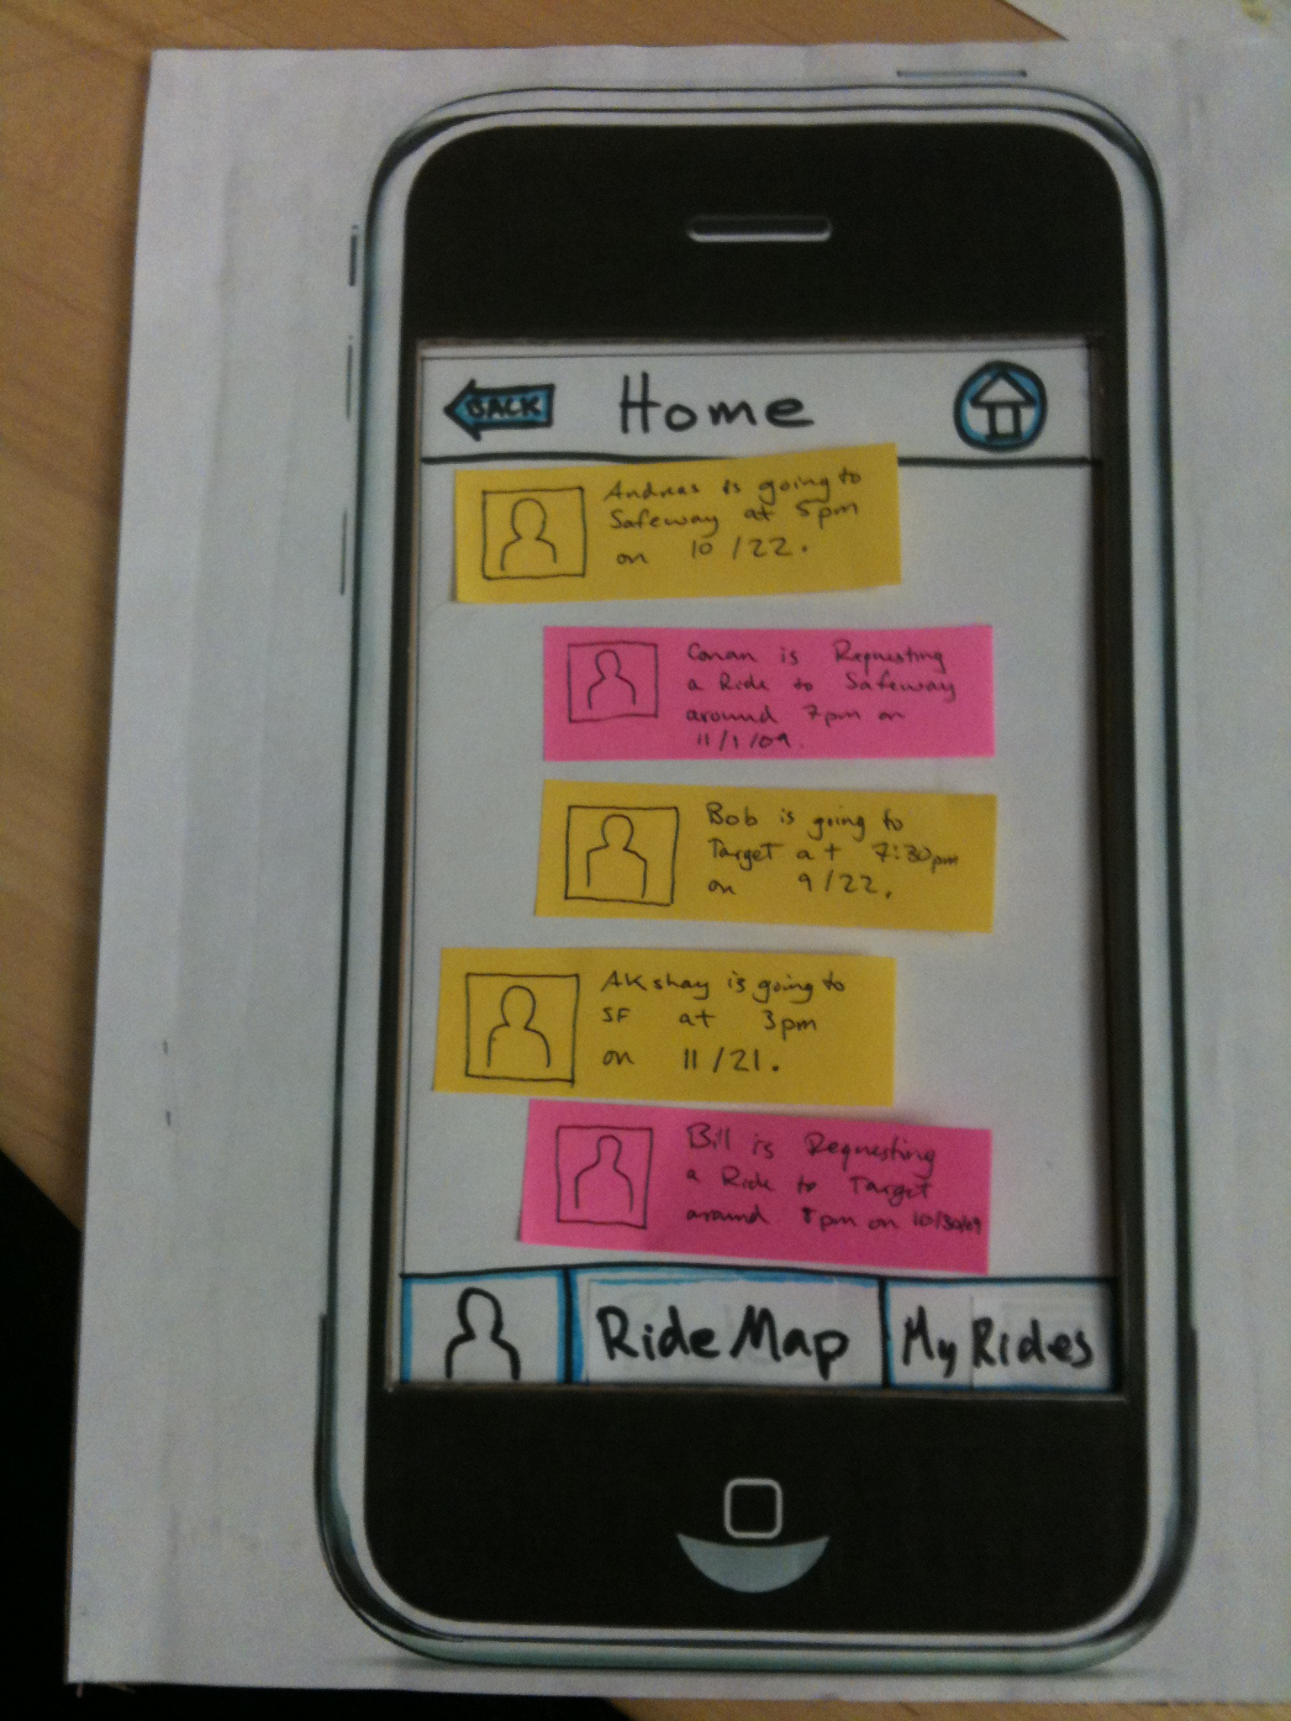

Paper prototyping

Slide 106
Video Prototyping

Slide 107
Functional Prototyping
HTML Mockups
Create a minimal design that will allow you to test user flows
Minimum Viable Product (MVP)
Launch a product with the minimum features and iterate

Slide 108


Evaluation
A/B Testing is king
Metrics, metrics, metrics
Gather user feedback

Slide 109

Questions?

